Slide 1
HR ANALYSIS PROJECT
DATA CLASSIFICATION MODELS

Slide 2
TABLE OF CONTENTS
DATA DESCRIPTION
QUESTIONS
MODELS
CONCLUSION

Slide 3
WORK PROCESS
DataSet pick up
TRANSFORMATION
DAY 02
DAY 04
DAY 01
DAY 03
DATA PROCESSING
DATA MODELING
Train_Test_Split
Scaling Data
Imbalance
Cleaning data and Visualization
LR , RF , DT, KNN XGBOSSTING

Slide 4
Data Set
The Dataset has 54000 rows and 14 columns.
Kaggle Datasets: https://www.kaggle.com/shivan118/hranalysis
Data Source

Slide 5
UNDERSTANDING THE PROBLEM
Every year, around 5% of its employees have promoted in the company. so, we have the check employee is promoted or not?

Slide 6
CHALLENGES
Effort
(over flow work)
Time of implantation
Meeting & Transfer
our files
Grid search

Slide 7
QUESTIONS

Slide 8
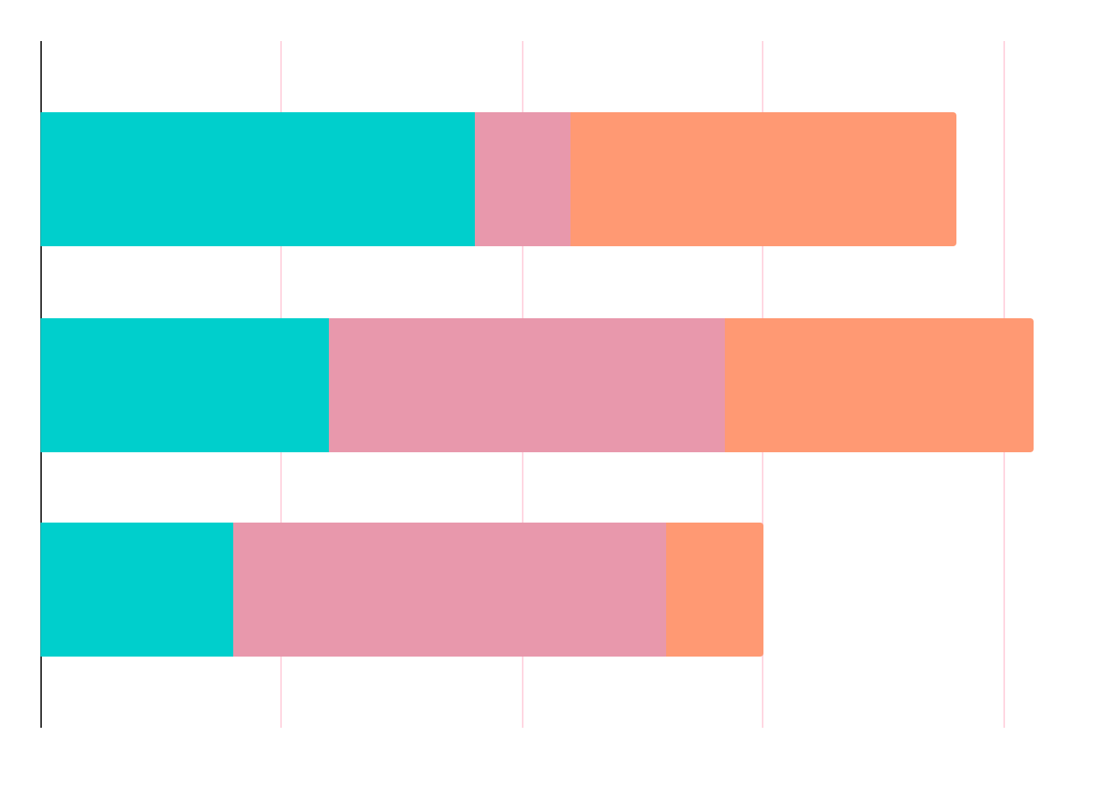
RESEARCH
Q1
Q2
Q3
How much the percentage of male vs female has been promoted ?
What is the average age of the employees ?
If KPI’s is high, does it affect the promotion ?

Slide 9
EDA
GENDER
AGE
20-39
70%
40-55
30%
38496, 70%
Male
54000
Employees
16312, 30%
Female

Slide 10
KPI’s
KPI’S > 80 % = 65%
KPI’S < 80% = 35 %

Slide 11
MODELS
02
03
01
Random Forest & DT
KNN
SVM
05
06
04
Logistic R
Light.GBM
XG.Boost

Slide 12
RESULT
SVM
XGBOOST
LIGHTGBM
RF
MODEL1: 70%
MODEL2: 74%
MODEL1: 86%
MODEL2: 84%
MODEL1: 84%
MODEL2: 83%
MODEL1: 78%
MODEL2: 75%

Slide 13
FINDINGS
OUTREACH
TOP RATED MODELS
30%
80%
50%
SVM,LightGB
XGBOOST
KNN

Slide 14
CONCLUSIONS
If we want to identify employees worthy of promotion as best as possible, we should choose the boosting classifier.
RF result it gave the close result to DT
Grid search improve our models with random (over-sampling) imbalance.

Slide 15
UPCOMING GOALS
CLASSIFICATION
DEVELOPMENT
AI
Update more Classification algorithms for across several parameters such as tenure, roles, reporting, etc.
frequently updated with new features in terms of usability, security, reporting, etc.
KPI’S WITH AI optimization strategy

Slide 16
Tools
Numpy , Pandas, Matplotlib , Seaborn, Sk_learn warning ,
Library
WORD ,PPT ,JUBYTER, ZOOM, HTML

Slide 17
THANKS
Prepared by:
ABDULLAH ALMORISHED
ALYA ALMANQOUR
FAHAD ALOMRAN

